Slide 1
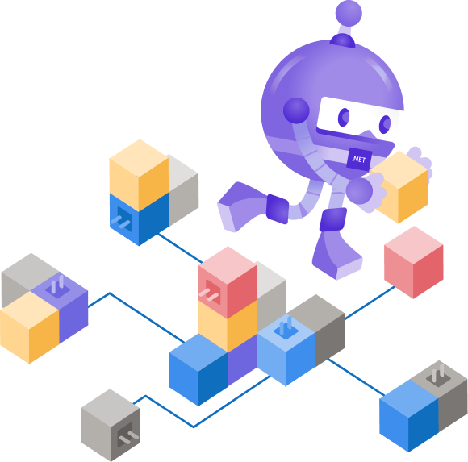
Evolving .NET Framework Monoliths with .NET 5 and Kubernetes
@EltonStoneman

Slide 2
Monoliths to Microservices: An Evolutionary Approach
Lifting and shifting
Introducing service facades
Encapsulating the service

Slide 3
Why? (An abridged list)
Modern portable platform
New technology stack
Service boundaries

Slide 4


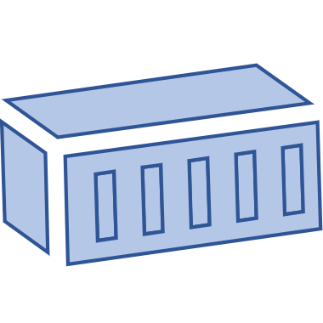
:80
Service: ingress
LoadBalancer
Pod: Nginx
Pod: petshop
App
.NET 3.5
Windows Server 2019
Kubernetes model
Pod: db
Ingress
Routing
Caching
SSL Termination

Slide 5
Demo 1
.NET Framework apps in Kubernetes

Slide 6
Lift & shift
Standard Kubernetes modelling
All the good Kubernetes features
But still the same app

Slide 7
:80
Service: ingress
LoadBalancer
Pod: Nginx
Pod: petshop
Pod: products
Pod: db
Service
New API
.NET 5
Windows or Linux

Slide 8
Demo 2
A new service in .NET 5

Slide 9
Evolution part 1
New modern API
Same toolset - Docker & Kubernetes
Lightweight, performant, multi-arch runtime
Security boundary

Slide 10

:80
Service: ingress
LoadBalancer
Pod: Nginx
Pod: petshop
Pod: products
Pod: db
Service
Encapsulated
App client
Decoupled

Slide 11
Demo 3
Encapsulating the service

Slide 12
Evolution part 2
Service encapsulation
Minor monolith changes
Repeatable pattern
May highlight design flaws :)

Slide 13
Docker & Kubernetes for .NET Devs | dak4.net
Learn Docker in a Month of Lunches | is.gd/aveluz
Learn Kubernetes in a Month of Lunches | is.gd/zoquco
Manning.com 40% discount | ctwnetconf20
Today’s demos | is.gd/bejuku

Slide 14

Thanks for joining !

